Slide 1
Stock Price Prediction
Team Member:
Dana Aboelyazid
Eman Taher
Yomna Tarek
Under the supervision: Prof.Dr Wessam El-Behaidy

Slide 2
Content
Brief notes about the paper and the problem solved by it
The architecture has been used to solve the problem and its result, the dataset used
Our architecture and the new dataset
Comparison between paper architecture and the new architecture

Slide 3
Brief notes about the paper
Paper’s name: Stock market prediction using deep learning algorithms
Date of publication: : 25 July 2021
Published in the CAAI Transactions on Intelligence Technology
Problem solved by this paper:
this paper addresses the problem of predicting stock market values accurately, especially during extreme market fluctuations such as the peak phase of the COVID-19 pandemic in March and April 2020. The study aims to provide insights into how to predict stock market values for consecutive days, even in volatile market conditions, to assist in making informed financial decisions .The researchers propose and compare different deep learning algorithms, including Backpropagation Artificial Neural Network and Convolutional Neural Network, to achieve high prediction accuracy

Slide 4
The architecture& dataset
Backpropagation Artificial Neural Network: This model utilizes the backpropagation algorithm on a simple artificial neural network to predict future stock market prices. It involves artificial neurons that take multiple inputs, multiply them by assigned weights, add a bias, and pass the result through an activation function to make predictions .
Convolutional Neural Network (CNN): The CNN model generates 2-D histograms from the quantized dataset within a specific time frame and uses them for prediction. This approach enhances training efficiency and prediction accuracy, especially during extreme market fluctuations like the COVID-19 pandemic.
Dataset: The NIFTY index is a well-known stock market index in India that represents the performance of the National Stock Exchange

Slide 5
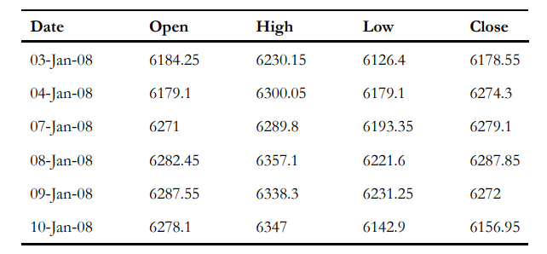
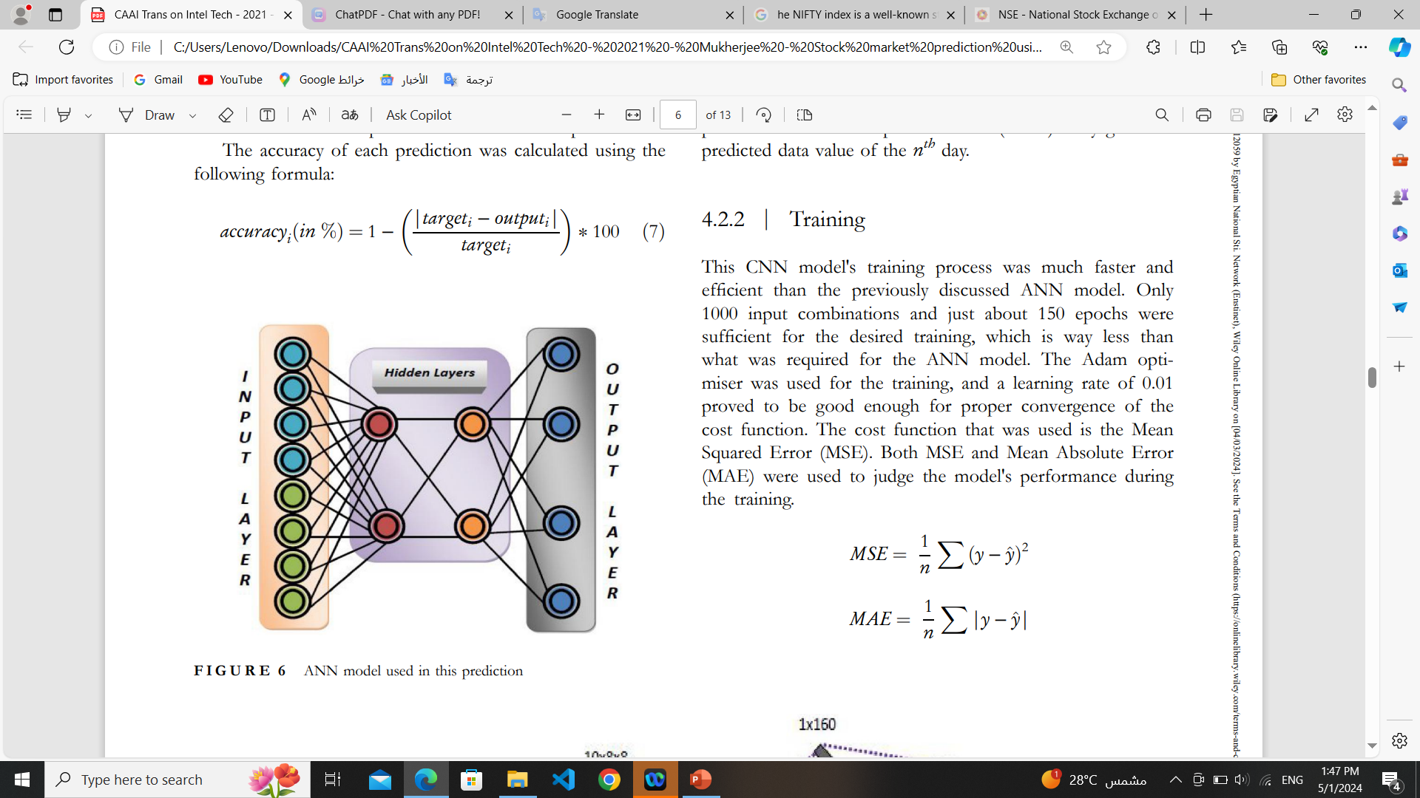
Using the ANN with backpropagation algorithm
The model is designed to have eight input neurons to accept the values of each of the four features of the previous two days
The number of hidden layers and the number of neurons in each of the two hidden layers were fixed at two after careful experimentation with higher values, which often led to over‐fitting and decreased prediction accuracy. The activation function that was used in the particular model is the sigmoid function
The model was trained with 2000 input combinations for more than 10,000 epochs with a learning rate of 0.1. The model was then tested with more than 2500 input combinations of stock price data.

Slide 6
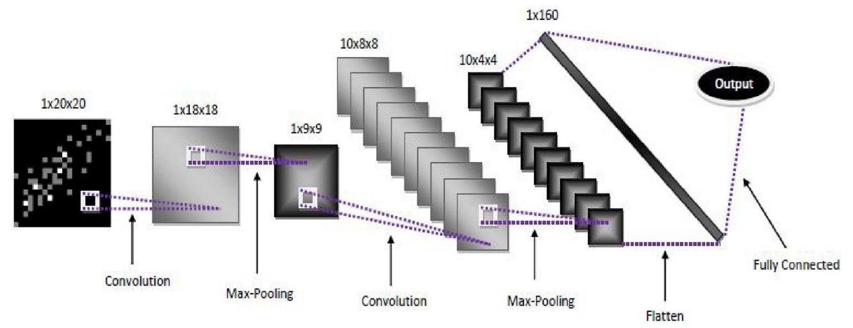
Using the convolutional neural network with 2‐D histograms
The study was further taken to the implementation of deep convolution neural networks in the field of stock market prediction.
Network Model :The network model designed for the prediction. The model takes the 20 x 20 matrix generated from a 2‐D histogram as input and generates a fraction as output. The predicted fraction multiplied with the ð(n − 1)^ th day gives the predicted data value of the n^th day.
Training: This CNN model's training process was much faster and efficient than the previously discussed ANN model. Only 1000 input combinations and 150 epochs were sufficient for the desired training, The cost function used is the Mean Squared Error (MSE), The model was tested with more than 1600 input combinations.

Slide 7
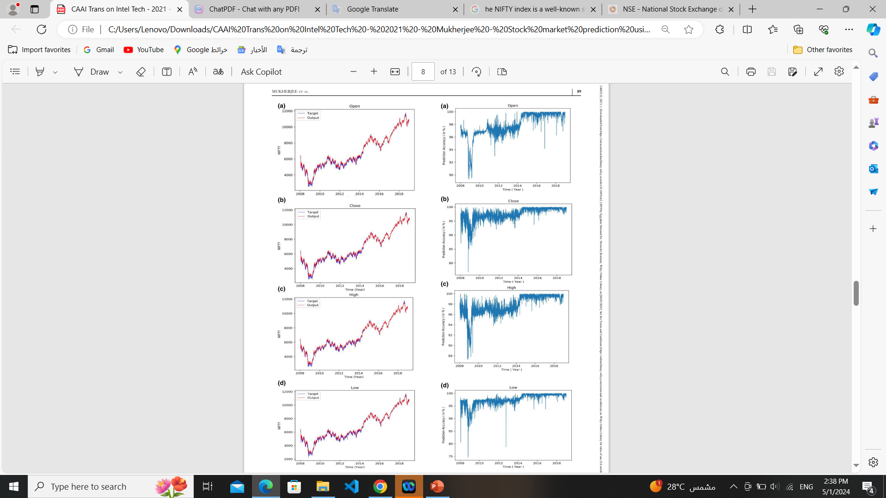
Result of the ANN
The model was tested with more than 2500 input combinations of stock price data, and it predicted the outputs with an accuracy of 97.66%. The time versus feature plot shows how the data moves according to the prescribed model. It also correlates the model with the expected output against the received output. Its accuracy layup structure accompanies each graph

Slide 8
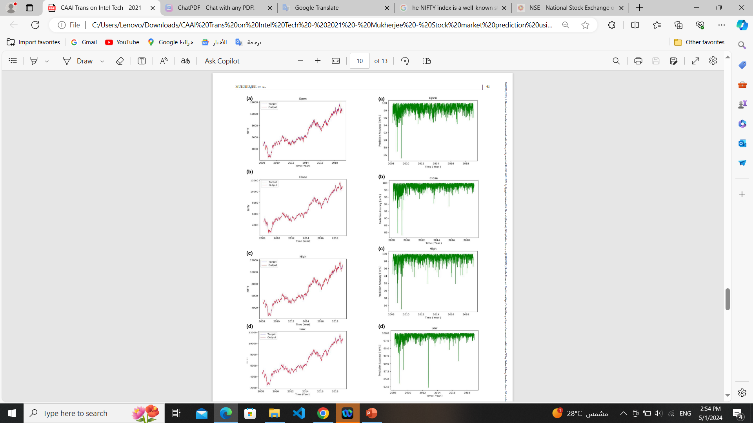
Result of CNN
The model was tested with more than 1600 input combinations or matrices.
the Convolutional Neural Network model gives 98.92% accuracy on the dataset

Slide 9
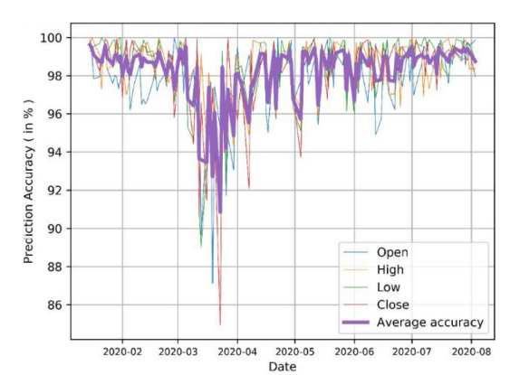
Conclusion
The working of CNN model is clearly better than that of the ANN model. This is because the ANN model loses context from the time series data before the CNN model. The dense connections with regularisation are not capable of retaining the time series context. This leads to the CNN model performing better than the ANN model, as it has more connections to get context from the dataset.

Slide 10
System Implementation
Load Dataset
Data Preprocessing
Data Normalization
Training The Model: CNN & LSTM
Testing The Model
Model Evaluation

Slide 11
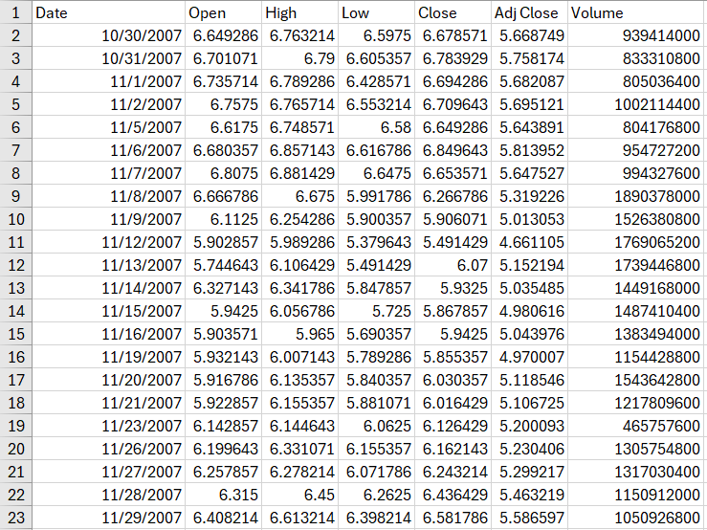
Data Description
Getting the Data
The first step is to get the data and load it to memory. We will get our stock data from the Yahoo Finance website and Kaggle.
The first dataset is sourced from the Yahoo Finance website, covering Apple stock data from 2007 to 2023. This dataset consists of 4027 rows and appears to represent stock market data.
The second dataset is sourced from Kaggle, covering Apple stock data from 2010 to 2016. This dataset consists of 1726 rows and appears to represent stock market data.
Understanding the Columns:
Date: Represents the date of the stock market data.
Open, High, Low, Close: These are typical OHLC prices for stocks.
Adj Close: Adjusted closing price, which accounts for corporate actions such as dividends, stock splits, etc.
Volume: the number of shares traded on a given day.

Slide 12
THANKS

